Slide 1
CIS041-3 Advanced Information Technology
Evaluation of Information Retrieval
Systems
Gangmin Li
(Office hours: 13:00-17:00 every Friday)

Slide 2
What we have learnt
Information is playing an increasingly important economic, social, political and technological role in many of our lives
Information is processed data/interpreted data
IS is a system to collect, process, store, transmit and display information
Information technology: Computer Technology and Network Technology to satisfy users’ information needs.

Slide 3
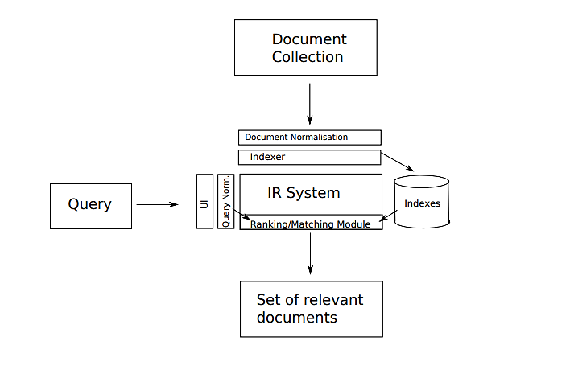
Most IR system

Slide 4
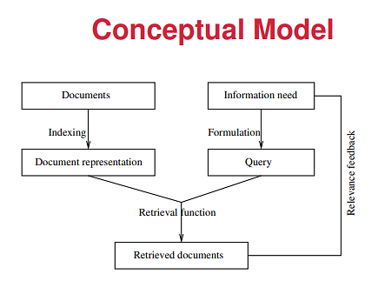
IR Solution model

Slide 5
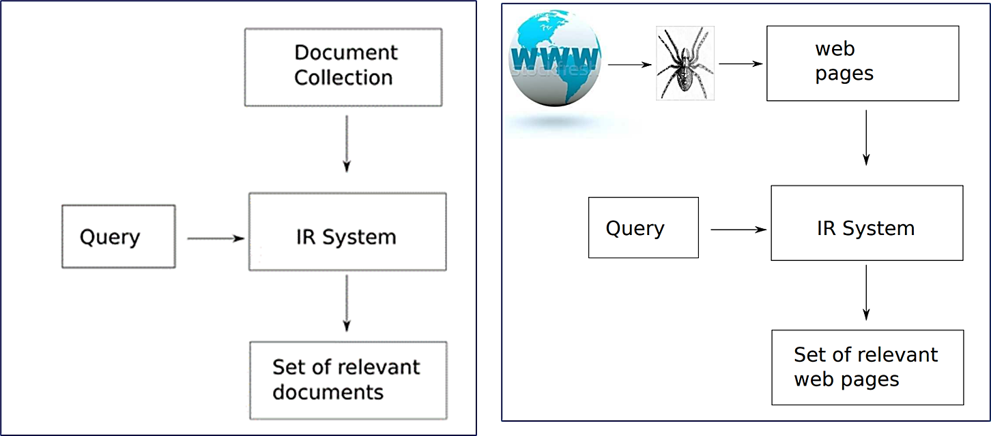
Two ways of IR

Slide 6
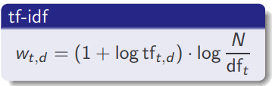
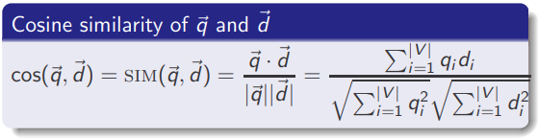
Classical IT
Boolean Retrieval model: information query is expressed using a Boolean expression (AND, OR and NOT).
Inverted Indexing -> set union and intersection
Extended Boolean models: phrases, biwords, N-gram, positional index.
need “Frequency” and “rank/group” results
Vector Space Retrieval mode

Slide 7
Web IR
The Search Behaviours: Surfing, Browsing, Searching
Web pages: read by a browser, formed in HTML and full of Hyper text (anchor text with hidden links)
IR is done by a web search engine
Google is the most dominate solution

Slide 8
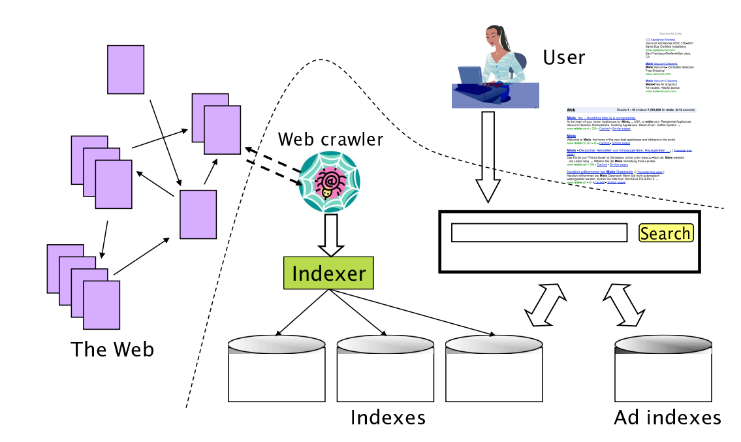




A web search engine

Slide 9
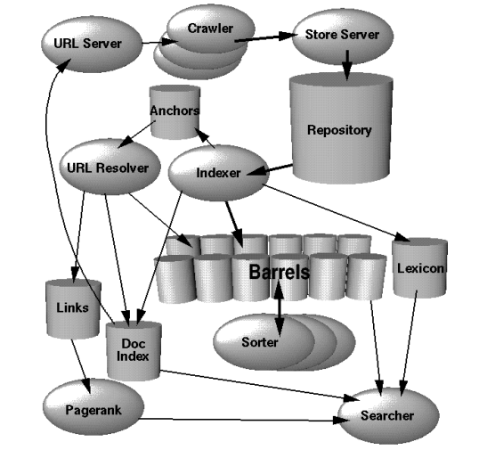
Google High Level Architecture [Brin and Page, 1998]

Slide 10
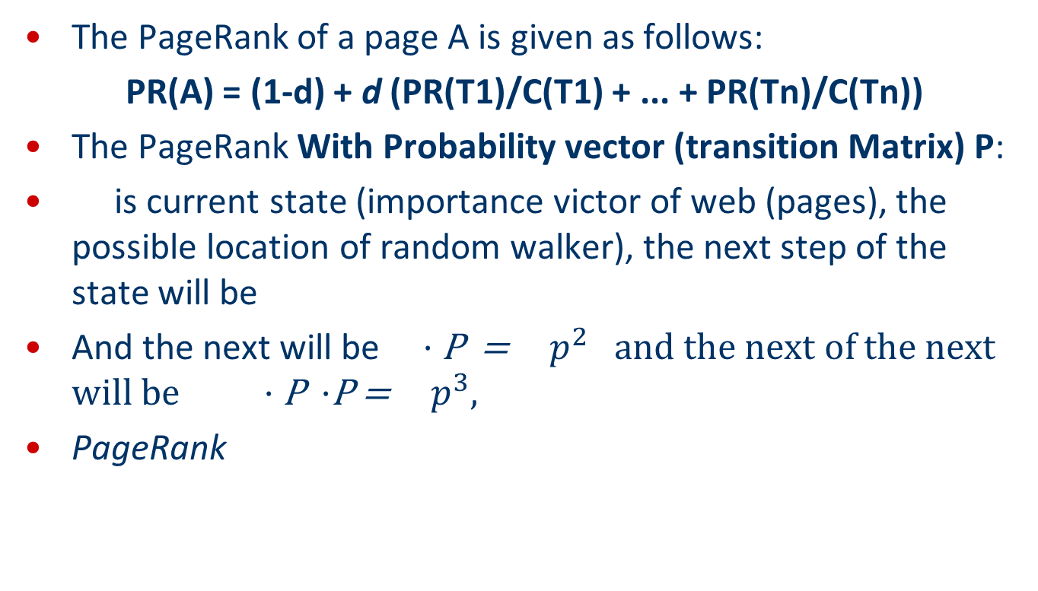
PageRank based on Links
The PageRank of a page A is given as follows:
PR(A) = (1-d) + d (PR(T1)/C(T1) + ... + PR(Tn)/C(Tn))
The PageRank With Probability vector (transition Matrix) P:
is current state (importance victor of web (pages), the possible location of random walker), the next step of the state will be
And the next will be · P = $p^{2}$ and the next of the next will be · P ·P = $p^{3},$
PageRank
http://pi.math.cornell.edu/~mec/Winter2009/RalucaRemus/Lecture3/lecture3.html

Slide 11
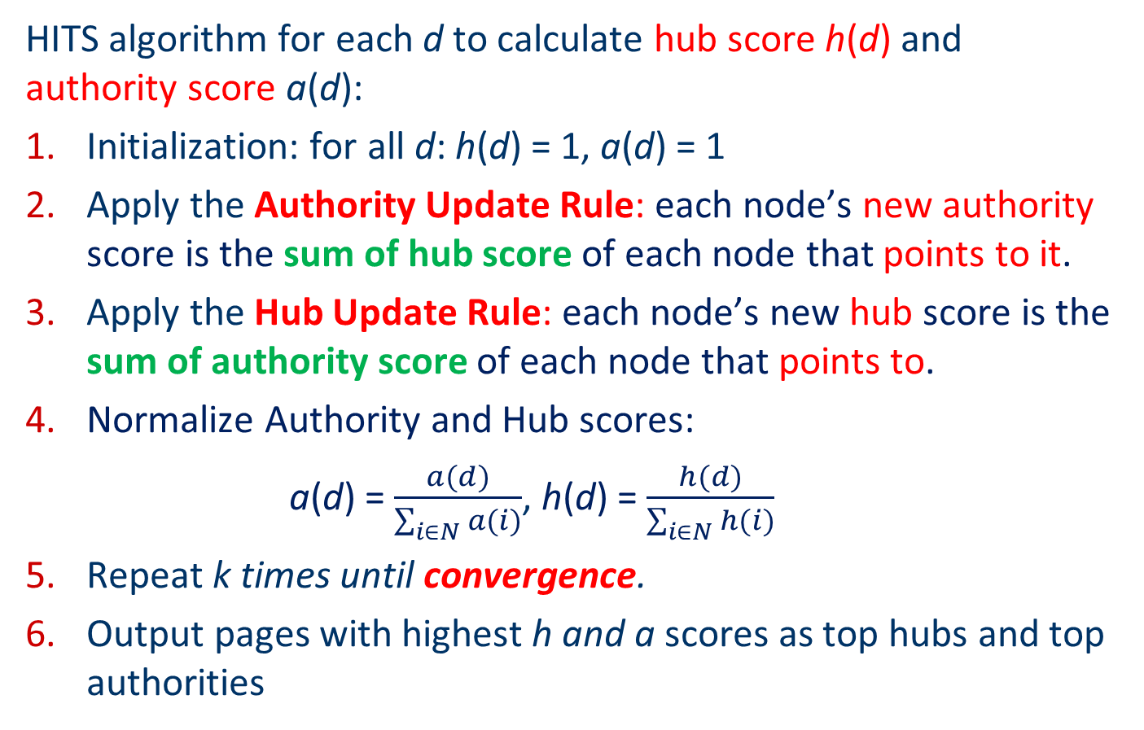
HITS Algorithm
HITS algorithm for each d to calculate hub score h(d) and authority score a(d):
Initialization: for all d: h(d) = 1, a(d) = 1
Apply the Authority Update Rule: each node’s new authority score is the sum of hub score of each node that points to it.
Apply the Hub Update Rule: each node’s new hub score is the sum of authority score of each node that points to.
Normalize Authority and Hub scores:
a(d) = $\frac{a(d)}{\sum_{i∈N}{a(i)}}$, h(d) = $\frac{h(d)}{\sum_{i∈N}{h(i)}}$
Repeat k times until convergence.
Output pages with highest h and a scores as top hubs and top authorities

Slide 12
Most IR system
Evaluation
how good are the returned documents?

Slide 13
Evaluation of IR
How well has the system performed?
How good the IR is?
What to measure? (Recall and precision)
Easy to use?
Capacity?
Efficacity?
Ultimate: information seeker’s Satisfaction!

Slide 14
Outline
Introduction
Unranked Return Evaluation
Ranked Return Evaluation
Benchmarks

Slide 15
1. Introduction for IR Evaluation

Slide 16
General measures for a search Engine
How fast does it index?
e.g., number of bytes per hour
How fast does it search?
e.g., latency as a function of queries per second
What is the cost per query?
in dollars
All of these criteria are measurable: we can quantify speed / size / money

Slide 17
The ultimate goal
The key measure for a search engine is user satisfaction.
Speed of response
Size of index
Uncluttered (clean) UI
We can measure
Rate of return
Whether something was bought (sold, purchase, profit, …)
Whether ads were clicked (marketing results)
Most important: relevance of the return
(actually, maybe even more important: is it free? - cost)
Note that none of these is sufficient: blindingly fast, but useless answers won’t make a user happy.

Slide 18
Relevance of the search results
User Satisfactory is equated with the relevance of search results to the query.
But how do you measure relevance?
Standard methodology in information retrieval consists of three elements.
A benchmark document collection
A benchmark suite of queries
An assessment of the relevance of each query-document pair

Slide 19
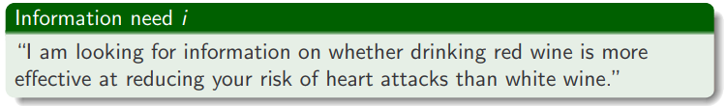

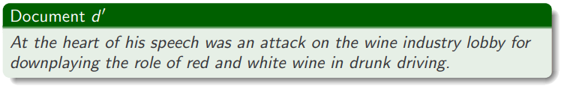
Relevance to: Query vs. information need
Question: Relevance to what? Information need i or Query q
translated into:
what about the following document:
d′ is an excellent match for query q . . .
d′ is not relevant to the information need i.

Slide 20
Relevance to: Query vs. Information need
Theoretically (ultimately)
User satisfactory should (can only) be measured by relevance to an information need, not by relevance to queries.
Practically (most of the literature)
We can only measure query–(return) document relevance.
So, that will be what we will be covering

Slide 21
2. Unranked Return Evaluation

Slide 22
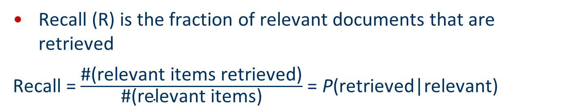
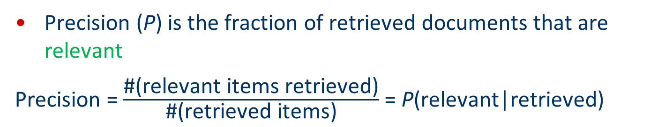
Precision and recall
(Recall in lecture one) The two most frequent and basic measures for information retrieval effectiveness are precision and recall:
Precision (P) is the fraction of retrieved documents that are relevant
Precision = $\frac{\text{\#(}\text{relevant} \text{items} \text{retrieved}\text{)}}{\text{\#(}\text{retrieved} \text{items}\text{)}}$ = P(relevant|retrieved)
Recall (R) is the fraction of relevant documents that are retrieved
Recall = $\frac{\text{\#(}\text{relevant} \text{items} \text{retrieved}\text{)}}{\text{\#(}\text{relevant} \text{items}\text{)}}$= P(retrieved|relevant)

Slide 23
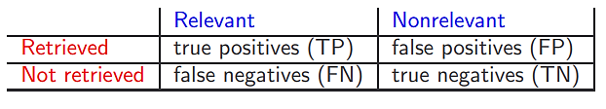
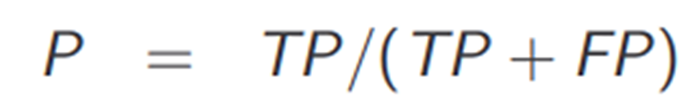
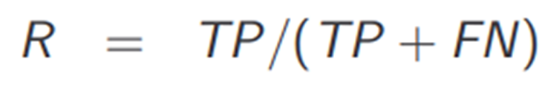
Precision and recall
Look a contingency table
The Truth
The System
Returns
Truth is Relevant
Return is Irrelevant (FN)
Truth is Relevant
Return is also Relevant (TP)
Truth is Irrelevant
Return is Relevant (FP)
Relevant (true)
Retrieved
Truth is Irrelevant
Return is Irrelevant (TN)
Irrelevant (Negative)

Slide 24


Precision and recall
Tricks:
You can increase recall by returning more docs.
Recall is a non-decreasing function of the number of docs retrieved.
A system that returns all docs has 100% recall!
The converse is also true (usually): It’s easy to get high precision for very low recall.

Slide 25

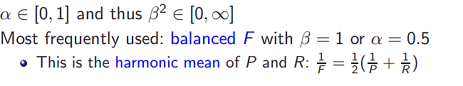

A combined measure: F1
F allows us to trade off precision against recall.
… is also called F1 score

Slide 26
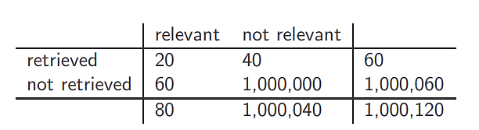
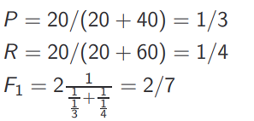
An Example
Given a contingency table as follows,

Slide 27
Why not using accuracy?
Accuracy: is a metric for any models that measures the number of correct (relevant-retrieved and irrelevant not retrieved) as a percentage of the total number.
In the context of measuring relevancy, it can be the fraction of relevant in the total.
In terms of the contingency table above,
accuracy = (TP + TN)/(TP + FP + FN + TN).

Slide 28
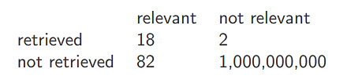
An Experiment
Compute precision, recall and F1 for this result set:
20
1,000,000,082
100
1,000,000,002
P = 18/(18 + 2) = 0.9
R = 18/(18 + 82) = 0.18
F1 = 2x (0.9X0.18)/(0.9+0.18) =0.39
Accuracy = (18+1,000,000,000)/1,000,000,102 =99.999

Slide 29
Why accuracy is a useless measure in IR
Almost any return (even 0) can have 99.99% accuracy if the collection is large.
So, to maximize accuracy in IR: always say no and return nothing
Searchers on the web (and in IR in general) want to find something and have a certain tolerance for junk.
It’s better to return some bad hits as long as you return something.
→ We can use precision, recall, and F1 for evaluation, not accuracy.

Slide 30
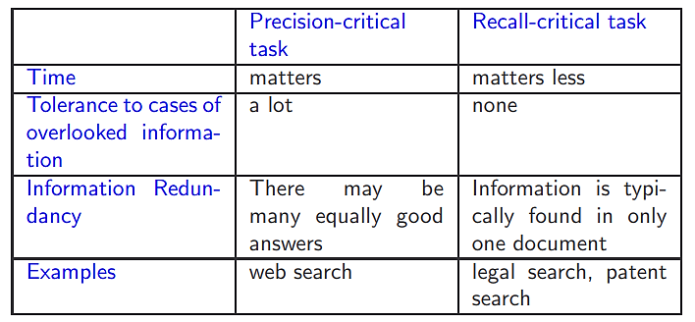
Recall-criticality and precision-criticality
Inverse relationship between precision and recall forces general systems to go for compromise between them
But some tasks particularly need good precision whereas others need good recall:

Slide 31
2. Ranked Return Evaluation

Slide 32
Moving from unranked to ranked evaluation
Precision/recall/F1 are measures for unranked returns (set).
We can easily turn Precision/recall/F1 measures into measures of ranked return (lists)
By compute the set measure for each “prefix”: the top 1, top 2, top 3, top 4 etc results
This is called Precision/Recall at Rank
Rank statistics give some indication of how quickly user will find relevant documents from ranked list

Slide 33
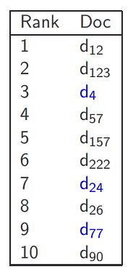
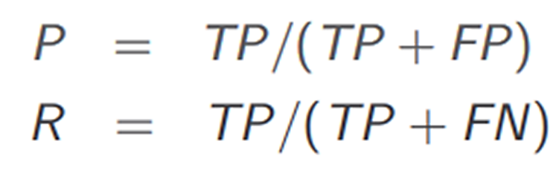
Precision/Recall @ Rank
Blue documents are relevant
P@n: P@3=0.33, P@5=0.2, P@8=0.25
R@n: R@3=0.33, R@5=0.33, R@8=0.66

Slide 34
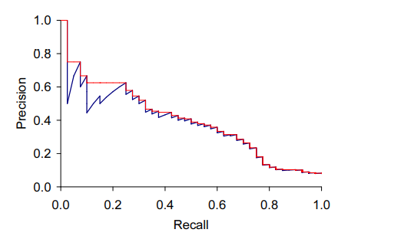

A precision-recall curve
For each set (k=1,2,…), plot precision and recall values.
have a distinctive saw-tooth shape: if the ${\text{(}\text{k}\text{ + 1)}}^{th}$ document retrieved is nonrelevant then recall is the same as for the top k documents, but precision has dropped. If it is relevant, then both precision and recall increase, and the curve jags up and to the right.
Each point corresponds to a result for the top k ranked hits (k = 1, 2, 3, 4, . . .)
Interpolation (in red): Take maximum of all future points
Rationale for interpolation: The user is willing to look at more stuff if both precision and recall get better.

Slide 35
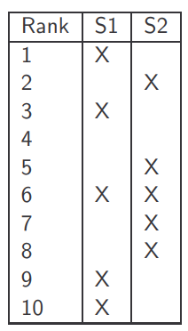
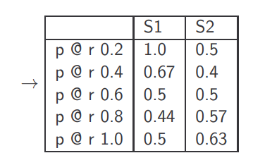
Precision at Recall p@r
Two systems S1 and S2 can be compared with p at certain r.
S1: r reaches 0.2 at the first return, so when r=0.2, p=1/1 = 1;
S2: r reaches 0.2 at the second return, so when r=0.2, p=1/2 = 0.5;

Slide 36
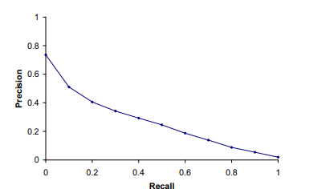
Averaged 11-point precision/recall graph
Compute interpolated precision at recall (p@r) levels 0.0, 0.1, 0.2, …, 1.0
Do this for each of the queries in the evaluation benchmark
Average all p over queries
The curve is typical of performance levels at TREC ( next slide)

Slide 37
*TREC
TREC - Text Retrieval Conference. The U.S. National Institute of Standards and Technology (NIST) has run a large IR test bed evaluation series since 1992. Within this framework, there have been many tracks over a range of different test collections, but the best known test collections are the ones used for the TREC Ad Hoc track during the first 8 TREC evaluations between 1992 and 1999. In total, these test collections comprise 6 CDs containing 1.89 million documents (mainly, but not exclusively, newswire articles) and relevance judgments for 450 information needs, which are called topics and specified in detailed text passages. Individual test collections are defined over different subsets of this data. The early TRECs each consisted of 50 information needs, evaluated over different but overlapping sets of documents. (more later slide 39)

Slide 38
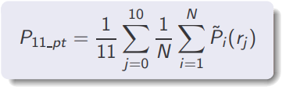
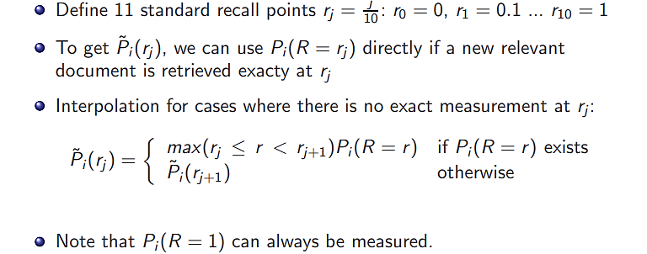
Averaged 11-point precision more formally

Slide 39
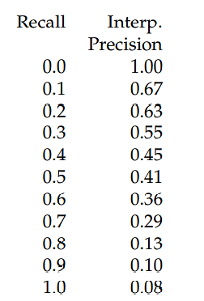
Averaged 11-point precision values
Averaged 11-point precision/recall values across 50 queries for a representative TREC system
The graph is shown at slides 28
The Mean Average Precision (MAP next slide) for this system is 0.2553.

Slide 40
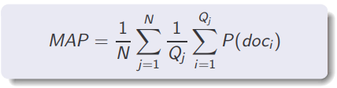

Mean Average Precision (MAP)
Not 11 values, just one value.
Also called “average precision at seen relevant documents”
Determine precision at each point when a new relevant document gets retrieved
Use P=0 for each relevant document that was not retrieved
Determine average for each query, then average over queries

Slide 41
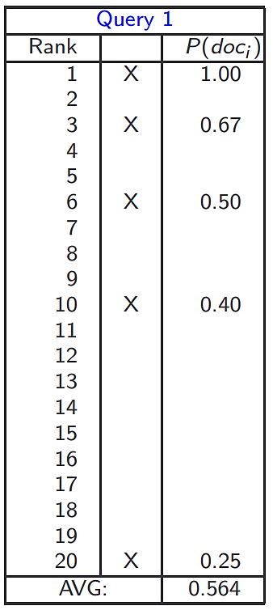
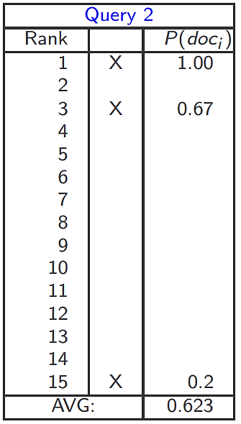
Mean Average Precision: example
MAP =
(0.564+0.623)/2
= 0.594

Slide 42
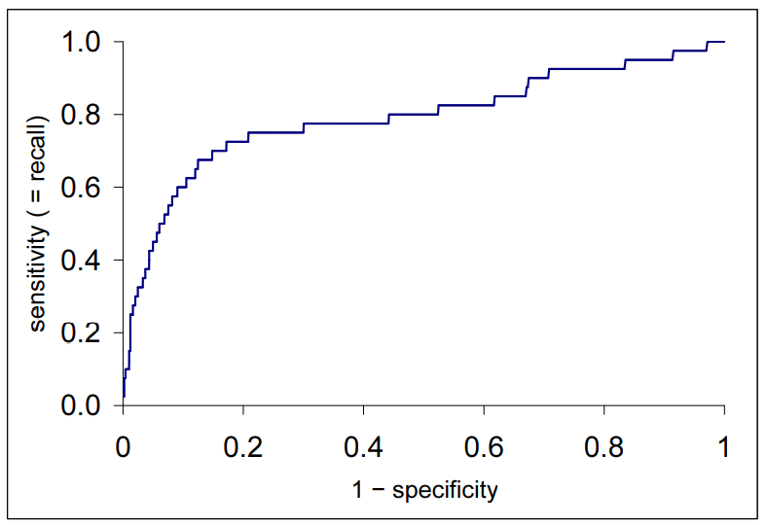
ROC curve (Receiver Operating Characteristic)
ROC curves are a convenient visual tool for analysing two classification models. A kind of accuracy measure.
x-axis: FPR (false positive rate): FP/total actual negatives (also called fall-out=1 - specificity);
y-axis: TPR (true positive rate): TP/total actual positives, (also called sensitivity) ≡ recall

Slide 43
Variance of measures like precision/recall
For a test collection, it is usual that a system does badly on some information needs (e.g., P = 0.2 at R = 0.1) and really well on others (e.g., P = 0.95 at R = 0.1).
Indeed, it is usually the case that the variance of the same system across queries is much greater than the variance of different systems on the same query.
That is, there are easy information needs and hard ones.

Slide 44
3. Benchmarks
Calibration with standards or human

Slide 45
What we need for a benchmark
A collection of documents
Documents must be representative of the documents we expect to see in reality.
A collection of information needs
. . . which we will often incorrectly refer to as queries
Information needs must be representative of the information needs we expect to see in reality.
Human relevance assessments
We need to hire/pay “judges” or assessors to do this.
Expensive, time-consuming
Judges must be representative of the users we expect to see in reality

Slide 46
First standard relevance benchmark: Cranfield
Pioneering: first testbed allowing precise quantitative measures of information retrieval effectiveness
Late 1950s, UK
1398 abstracts of aerodynamics journal articles, a set of 225 queries, exhaustive relevance judgments of all query-document-pairs
Too small, too untypical for serious IR evaluation today

Slide 47
Second-generation relevance benchmark: TREC
TREC = Text Retrieval Conference (TREC)
Organized by the U.S. National Institute of Standards and Technology (NIST)
TREC is actually a set of several different relevance benchmarks.
Best known: TREC Ad Hoc, used for first 8 TREC evaluations between 1992 and 1999
1.89 million documents, mainly newswire articles, 450 information needs
No exhaustive relevance judgments – too expensive
Rather, NIST assessors’ relevance judgments are available only for the documents that were among the top k returned for some system which was entered in the TREC evaluation for which the information need was developed.

Slide 48
Sample TREC Query
<num> Number: 508
<title> hair loss is a symptom of what diseases
<desc> Description:
Find diseases for which hair loss is a symptom.
<narr> Narrative:
A document is relevant if it positively connects the loss of head hair in humans with a specific disease. In this context, “thinning hair” and “hair loss” are synonymous. Loss of body and/or facial hair is irrelevant, as is hair loss caused by drug therapy.

Slide 49
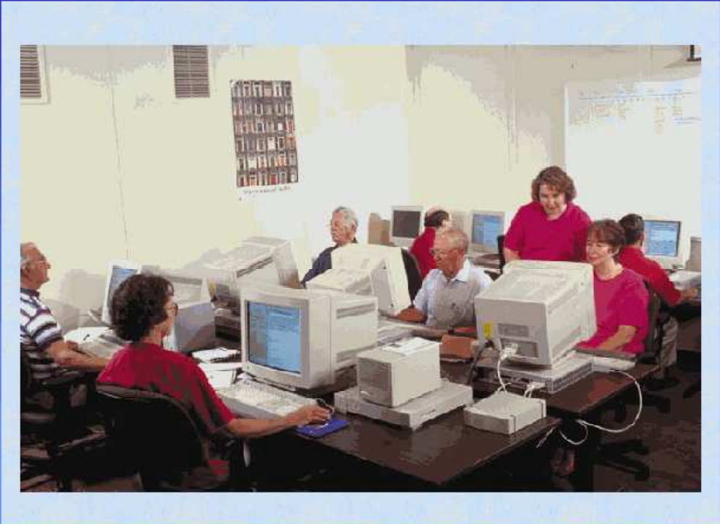
TREC Relevance Judgements
Humans decide which document–query pairs are relevant.

Slide 50
Example of more recent benchmark: ClueWeb09
1 billion web pages
25 terabytes (compressed: 5 terabyte)
Collected January/February 2009
10 languages
Unique URLs: 4,780,950,903 (325 GB uncompressed, 105 GB compressed)
Total Outlinks: 7,944,351,835 (71 GB uncompressed, 24 GB compressed)

Slide 51
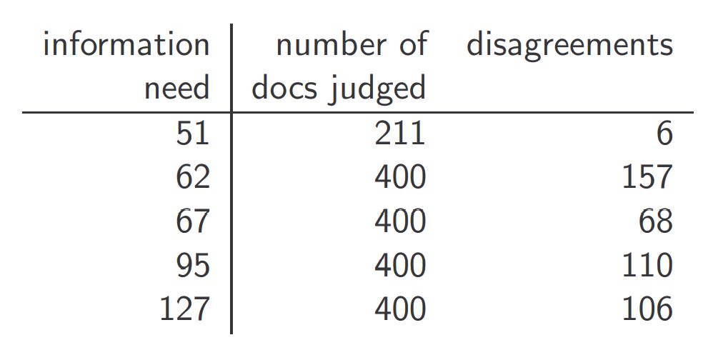
Interjudge agreement at TREC

Slide 52
Impact of interjudge disagreement
Judges disagree a lot. Does that mean that the results of information retrieval experiments are meaningless?
No.
Large impact on absolute performance numbers
Virtually no impact on ranking of systems
Supposes we want to know if algorithm A is better than algorithm B An information retrieval experiment will give us a reliable answer to this question . . .
. . . even if there is a lot of disagreement between judges.

Slide 53
Other types of evaluation
Evaluation at large search engines:
Recall is difficult to measure on the web
Search engines often use precision at top k (return), e.g., k = 10 . . .
. . . or use measures that reward you more for getting rank 1 right than for getting rank 10 right.
Search engines also use non-relevance-based measures.
Example 1: clickthrough on first result
Not very reliable if you look at a single clickthrough (you may realize after clicking that the summary was misleading and the document is nonrelevant) . . .
. . . but pretty reliable in the aggregate.
Example 2: A/B testing

Slide 54
A/B testing
Purpose: Test a single innovation
Prerequisite: You have a large search engine up and running.
Have most users use old system
Divert a small proportion of traffic (e.g., 1%) to the new system that includes the innovation
Evaluate with an “automatic” measure like clickthrough on first result
Now we can directly see if the innovation does improve user happiness.
Probably the evaluation methodology that large search engines trust most

Slide 55
Summary
Evaluation for ad-hoc retrieval
Precision, Recall, F1-measure
More complex measures for ranked retrieval
typically use P/R-based measures
Evaluation for interactive tasks is more involved
Significance testing is an issue (considering…)
could a good result have occurred by chance?
is the result robust across different document sets?
slowly becoming more common
underlying population distributions unknown, so apply non-parametric tests such as the sign test

Slide 56
Reading
Book Chapter 8 available on BREO
Google:
TREC information retrieval
Precision, recall and F1
ROC
A/B test

